Slide 1
Pixel int id int r int g int b RGB Accessors and Mutators
Image str type str in_address str out_address vector<Pixel> pixels bool loaded virtual LoadImage() virtual SaveImage() virtual Filter1() virtual Filter2() …
BMP LoadImage() SaveImage() Filter1() Filter2()
...
…

Slide 2
void Image::Type::LoadImage(str in_address)
Load image at in_address
Read every pixel: get R G and B values, assign ID
Store each pixel in vector<Pixel> pixels for the Image object
MUST CHECK FOR:
Valid in_address
Valid format (BMP, etc.)

Slide 3
Pixel::Pixel(int id, int r, int g, int b)
Constructor must give it an id, and initial RGB values
MUST CHECK:
r, g, b should be <= 255

Slide 4
Void Image::Type::Filter1()
Will read every pixel of the Image object, from vector<Pixel> pixels
Will modify values of R G B for each pixel
How they modify will depend on the type of filter

Slide 5
Int Pixel::GetRed()
Will return the current R value for the pixel
GetBlue() and GetGreen() should do the same for B and G colours;

Slide 6
void Pixel::SetRed(int r)
Will modify the current R value for the pixel to a given integer r;
SetBlue() and SetGreen() should do the same for B and G colours;
MUST CHECK:
Input <= 255

Slide 7
Void Image::Type::SaveImage(int out_address)
Reads every pixel in vector<Pixel> pixels from an Image object
Outputs to a file in same format
MUST CHECK FOR:
Valid output_address

Slide 8
Styles
Class
Object
MyFunction
my_variable
my_private_variable_
_MY_CONSTANT
_MY_PRIVATE_CONSTANT_

Slide 9
Interface
Present
Load Image
Choose Filter
Name
Aims
How to use
Version 1.0.0
request file path
Chose saving (y/n)
Path name
Display Image

Slide 10
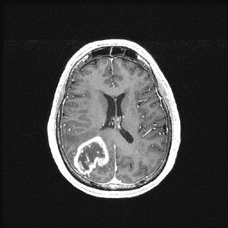


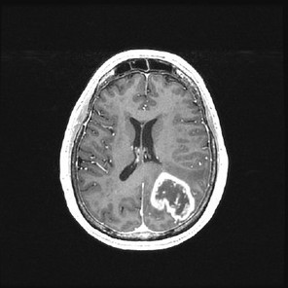
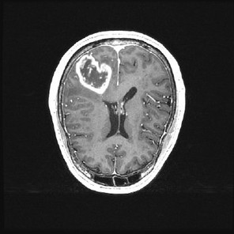
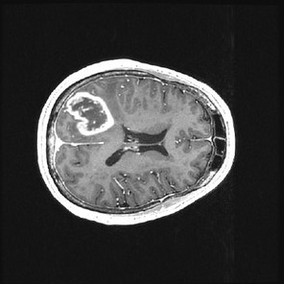
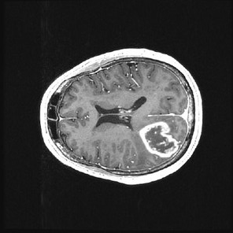
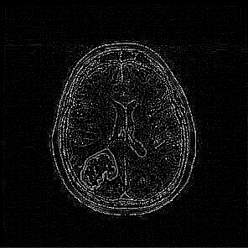
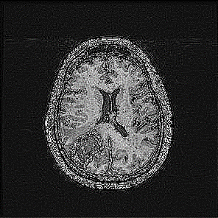
Original | Gaussian Blur (4) | Box Blur (4)
Horizontal Flip | Vertical Flip | Rotation Clockwise
Rotation Anticlockwise | Edge Detection (1) | Sharpen (2)
Notes:
PPM

